Slide 1

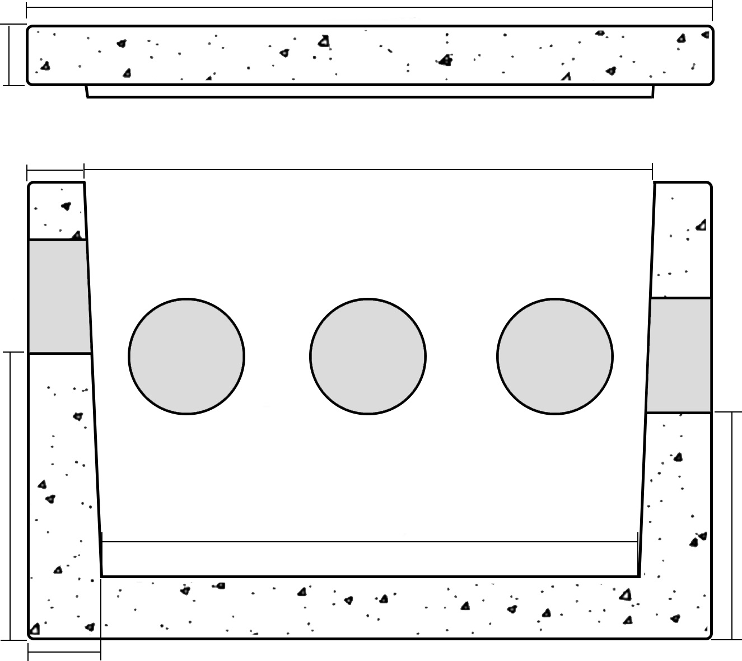
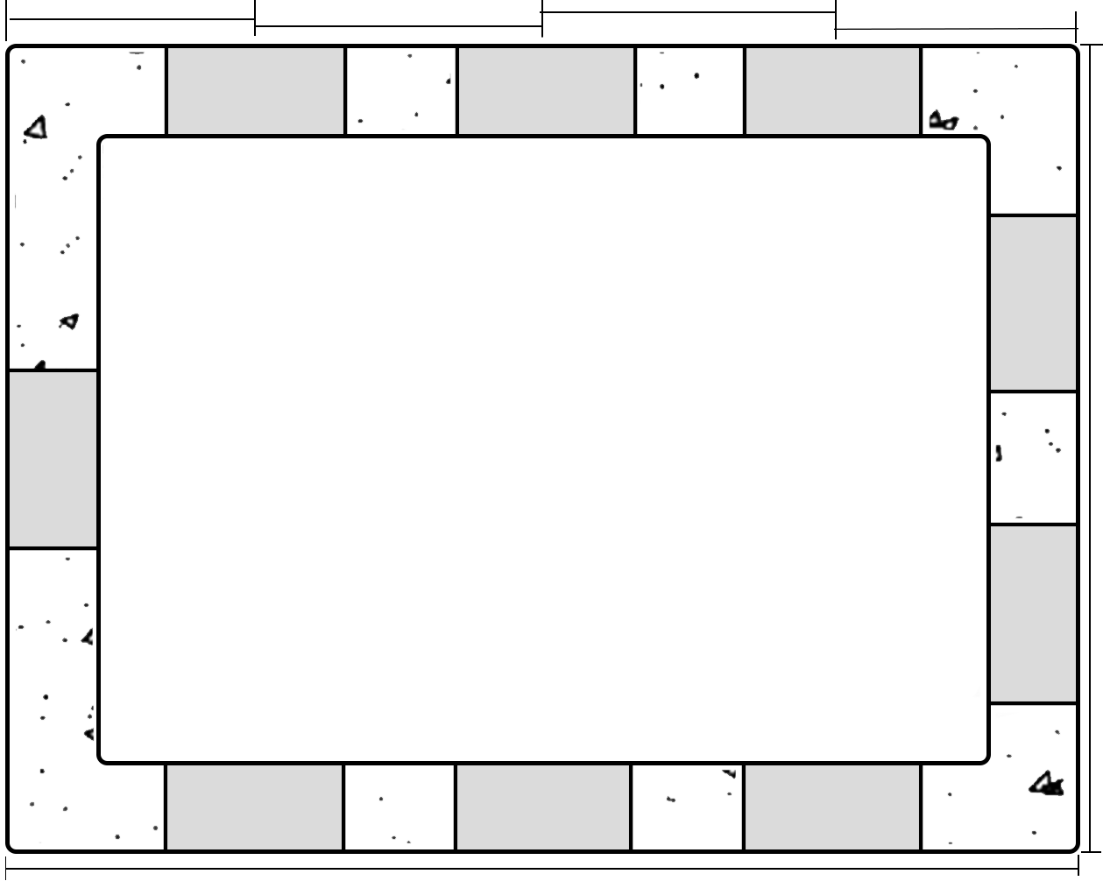
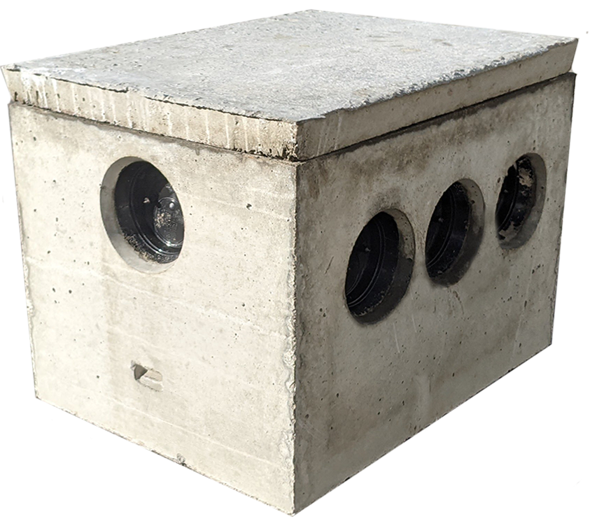
9 HOLE DISTRIBUTION BOX
24”x18”
2”
COVER
24”
2”
20”
SIDE VIEW
TOP VIEW
18”
10”
19”
8”
2.5”
5.5”
6.5”
6.5”
5.5”
USI ITEM #:
DBOX9
NOTES:
-5,000 PSI CONCRETE AFTER 28 DAYS
-3D REINFORCEMENT USING MACROSYNTHETIC FIBER.
ITEM DESCRIPTION:
9 HOLE DISTRIBUTION BOX
82 STATE RD.
WHATELY, MA 01093
413-397-3412
undergroundsupplyinc.com
CASTING WEIGHT(S):
NO LID – 235 #
W/ LID – 315 #

